Slide 1
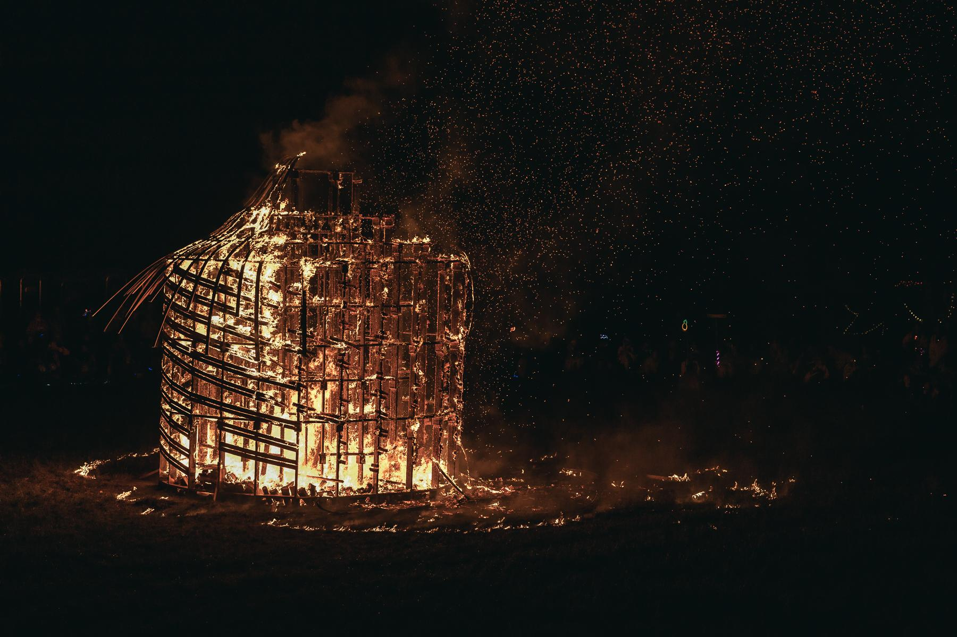

Effigy & Temple
2026 Information Session

Slide 2
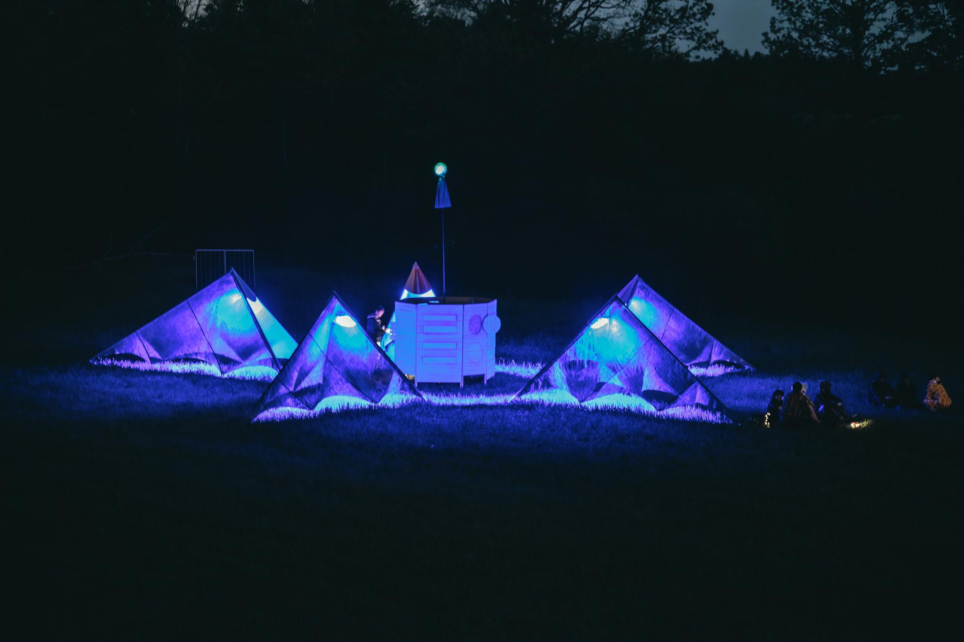

The Great Rewilding
14-18 May 2026

Slide 3
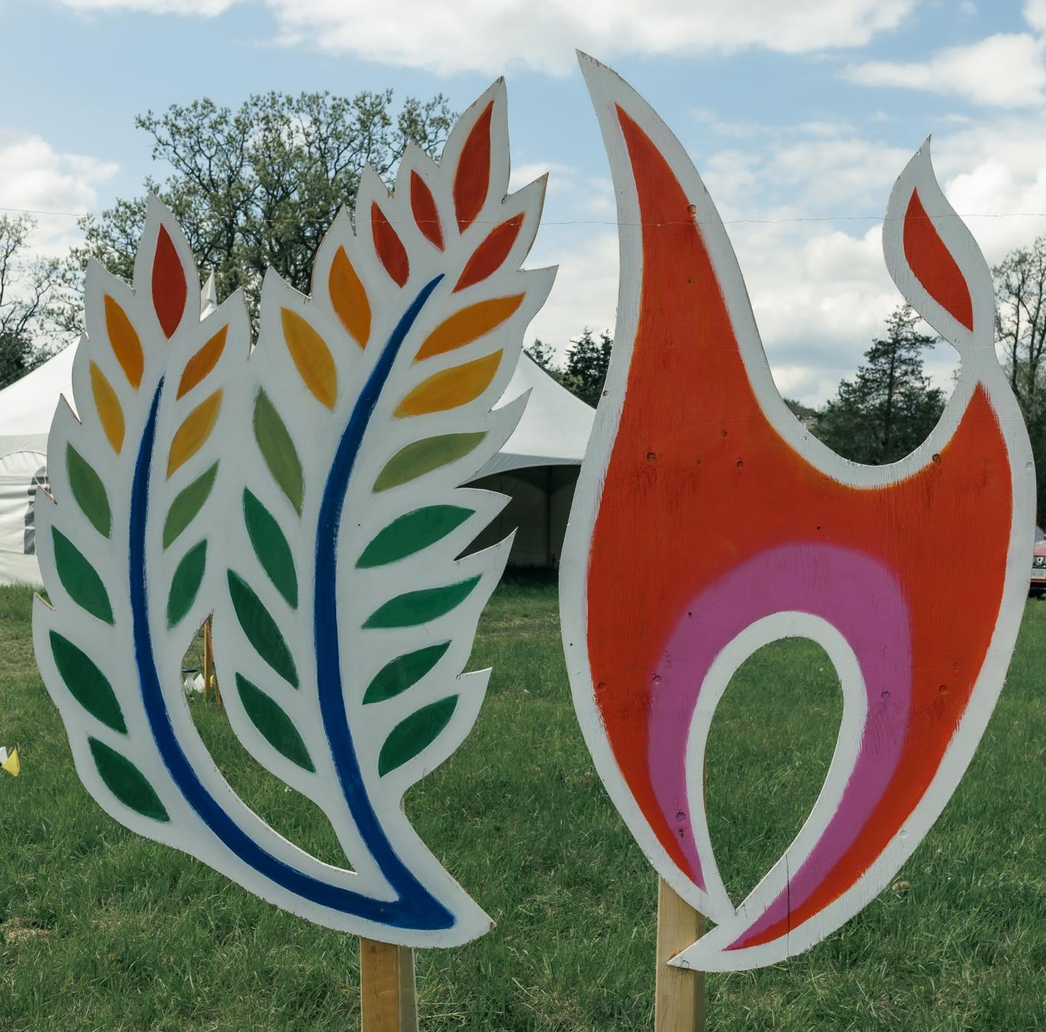
What is SideBurn?
A sanctioned Burning Man Regional Event.
We are guided by the 10 Principles of Burning Man.
It is run by a volunteer board of 12+ all year round. We have a healthy, long-standing, incorporated non-profit organisation behind the event.
The event has two ‘burn’ nights, Saturday and Sunday, where we burn two unique art pieces built out of wood.
We offer the opportunity for participants to come and unplug and camp for 4 days in Stone Mills.
We all bring the fun!
© captured by CARO

Slide 4
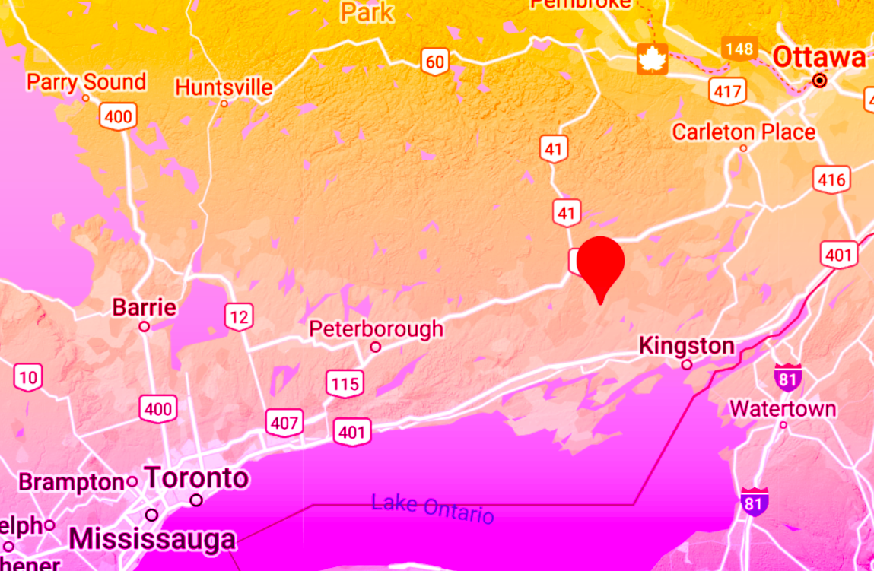
Where is SideBurn?
May 14-18 2026, Stone Mills, ON
2.5 hr drive from Toronto ………………………….
……………………………... 2 hr drive from Ottawa
(north of Kingston)
Notes:
Same site as last year!

Slide 5
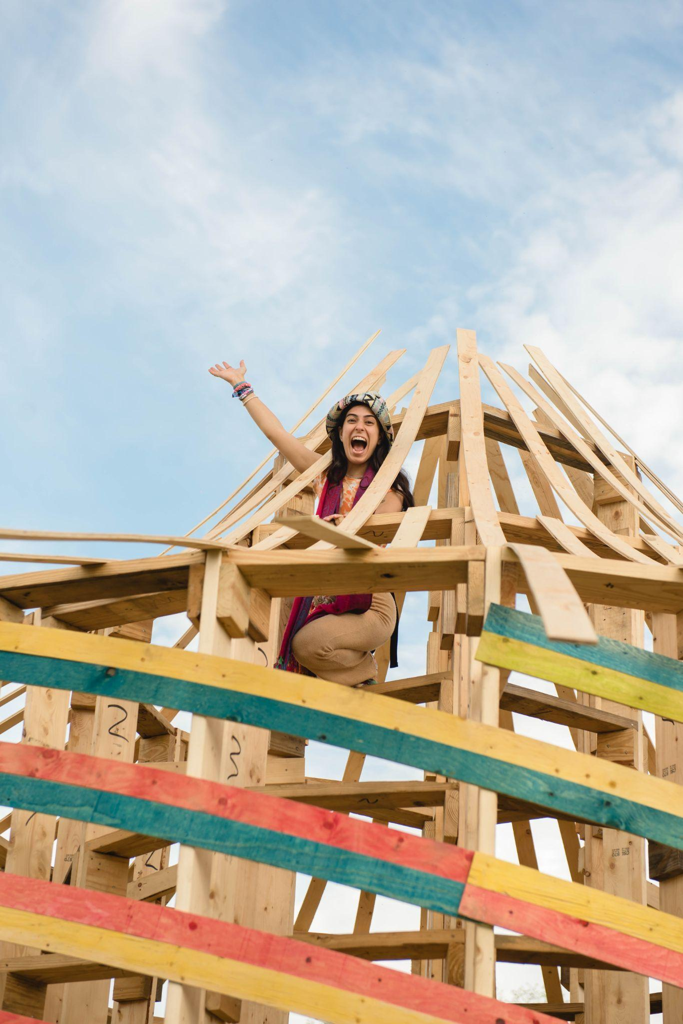
What is the Effigy?
The effigy is the “central” structure of our burn event.
The effigy can be thought of as a space for community, for coming together, for engagement, for play, and for whatever participants bring to it.
The effigy is burned on Saturday night of SideBurn. It is typically a big, celebratory event, sometimes opened by music and fire spinning.

Slide 6
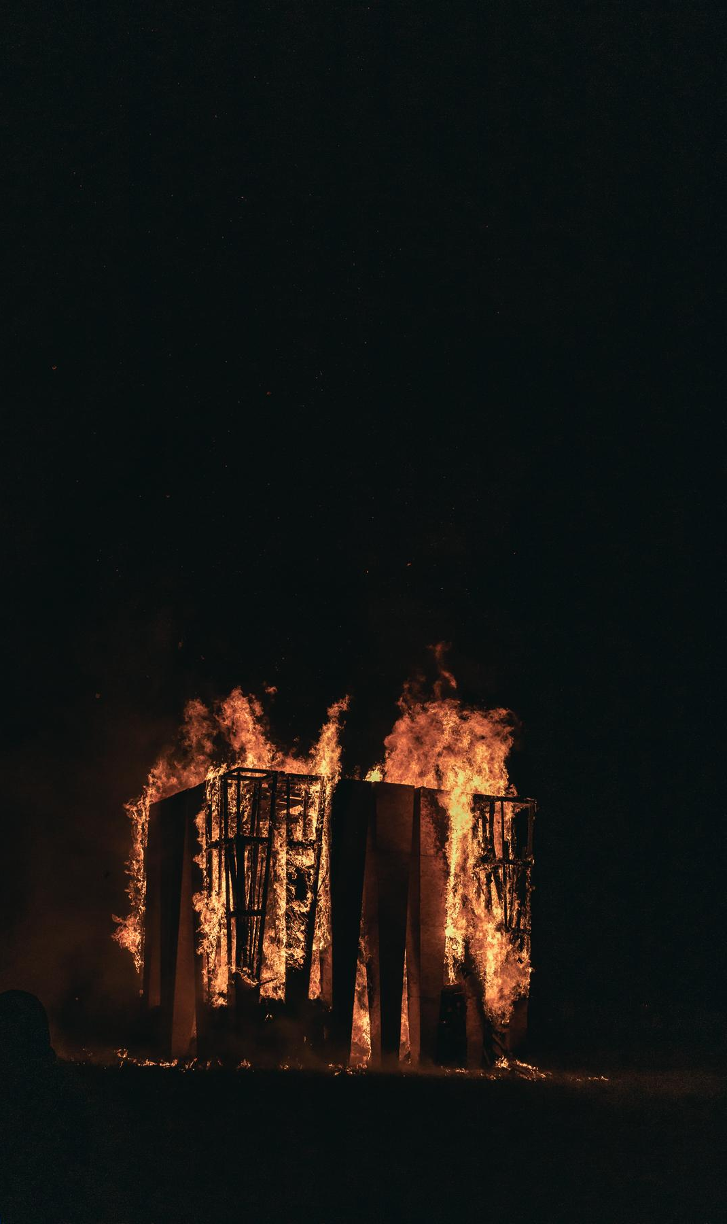
What is the Temple?
What is the Temple?
The Temple is a non-religious, non-denominational intentional space of contemplation, feeling, memory, processing, grieving, and/or letting go. It means something different to everyone who comes to it, but is intended to offer a reflective space for the more difficult parts of being human together.
The Temple is burned in silence at Sunset on the last evening of SideBurn.

Slide 7
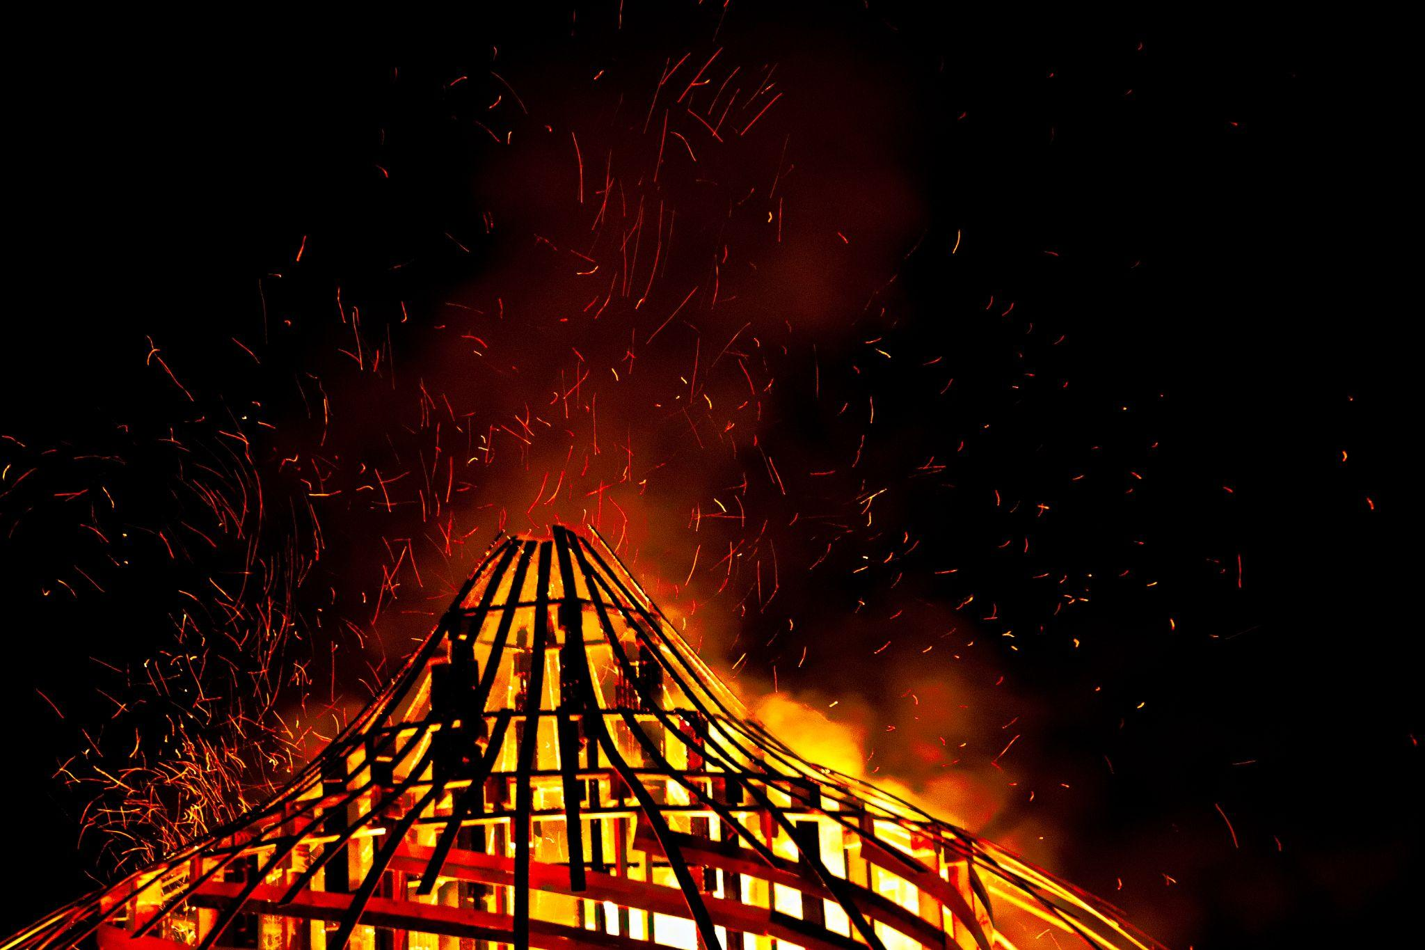
Grant Amounts
SideBurn offers:
Temple Grant $5,500 CAD
Effigy Grant $5,500 CAD
75% of this amount is released right away when you accept the grant and sign the artist contract
The remaining 25% is released after the event
Notes:
The Art Grant Program is intended to support and promote projects that foster the participatory spirit at the core of the event. We provide funding for radically expressive, community-based, interactive, experimental, and cross-disciplinary projects that help define the creative atmosphere we strive to curate.

Slide 8
Timeline & Deadlines
December 9, 2025: Virtual info session and Q&A
December 21, 2025: Expression of Intent - 1st step of application due
January 2026: ART + FAST teams will meet with applicants and invite select applicants to complete the full application
January 31, 2026: Full application - 2nd stage due
TEMPLE & EFFIGY AWARD DATE: February 14, 2026
Late February, 2026 directed ticket purchases open for artists & build teams
ON-SITE EARLY ARRIVAL May 11-14, 2026

Slide 9
Artist Expectations
The artist shall be responsible for:
Stage 1: Contract
Acceptance of grant by signing and returning the Art Grant Contract
Stage 2: Planning & Preparation
Submission of any additional safety documentation (if required)
Updating the Art department on the progress of the project, including any major changes or modifications to the project
Stage 3: Execution
Delivery of the project as described (or having notified the Art department of any major changes to the proposed project):
Build/set up of the project at SideBurn according to the timelines in the Art Grant Contract
Check in at the Artery for placement upon arrival, and report completion of setup
Ongoing maintenance of the project during the event: checking the artwork daily for safety and security (ex. guy wires); supervision during operation hours if required (ex. if the project includes flame effects); regular leave-no-trace sweeps of the project area during the event.
Stage 4: Completion
De-installation of the project on the date agreed upon in the Art Grant Contract
Successful leave-no-trace inspection of the project area
Submission of project receipts to art@sideburn.ca

Slide 10
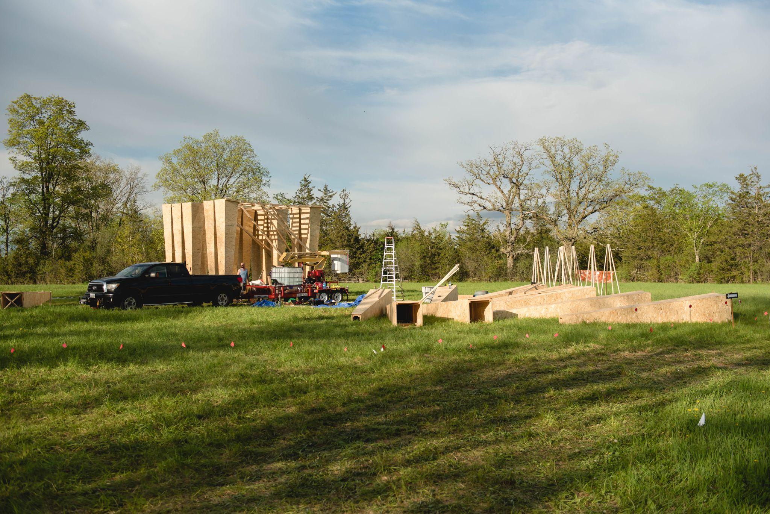
HOW IT WORKS: CRITERIA & REVIEW
The Art Leads will receive the Stage 1 and Stage 2 applications.
With members of FAST (Fire Art Safety Team), art leads will vet applications from a structural and fire safety perspective.
If there are multiple Temple or Effigy applications that are deemed feasible, the art team will assess them on the following criteria…
Notes:
MENTION: we’re still looking for committee members! Email art@sideburn.ca to learn more.

Slide 11
HOW IT WORKS: CRITERIA & REVIEW
Creativity: How original, interesting, relevant, daring, magical, and thought provoking is your idea?
Construction: Is your project feasible? Will you be able to build it within your proposed timeline and budget? Are you accountable for fire art restrictions and other safety considerations (ex. anchoring)?
Completeness: How well-thought-out is your project? How complete are your materials list, safety plan, and Leave No Trace plan?
Interactivity: Does your project engage the senses? We prioritize projects that have the ability to engage two or more senses at a time!
© captured by CARO
Notes:
1. Artistic Excellence (Design & Philosophy)
How original, interesting, relevant, daring, magical, thought-provoking is your idea?
2. Completeness of Design
How well-thought-out is your project? You should provide enough information for us to imagine your creation and how it comes together.
3. Feasibility & Constructability
How feasible is your idea? Will it stay together? You should have a detailed plan for both the technical construction of your project as well as a schedule to ensure it happens on time, with buffers for potential setbacks.
4. Appropriateness of Budget
Your budget should have reasonable costs that match the value of your materials.
5. MOOP/LNT Plan
Your project should have minimal waste production, and a plan for cleaning any possible Matter Out Of Place (MOOP) that could be produced during the installation or strike of your project. This includes a plan for Leave No Trace (LNT) cleanup of ashes and refuse produced during the burn.
6. Safety and Risk Mitigation Plan
Yeah, we get it. Art is dangerous sometimes. But make sure you have a plan to minimize the amount of harm that can come to people interacting with your project.
7. Burn Plan and Ignition Plan
If your art project includes fire you must submit a burn plan with your application. This plan will be reviewed by our F.A.S.T team and grants will only be awarded to projects that have been approved. See here for a guide to creating a Burn Plan

Slide 12
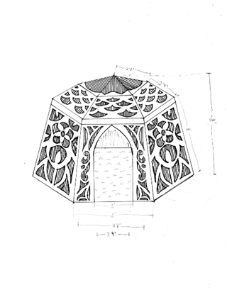
Supporting Documents: Budget, Renderings/Diagrams
All grant applications should include at least one image: a sketch, hand drawn rendering, or computer generated renderings are all acceptable
All projects should include a budget - a list of materials and anticipated costs, transportation expenses, and any equipment rental or workshop expenses
Submissions involving FIRE should include a fuel storage plan, and operational safety plan
MAXIMUM dimensions (smaller is ok!):
20x20x20 feet
Notes:
Upload your supporting documents directly on our website!

Slide 13
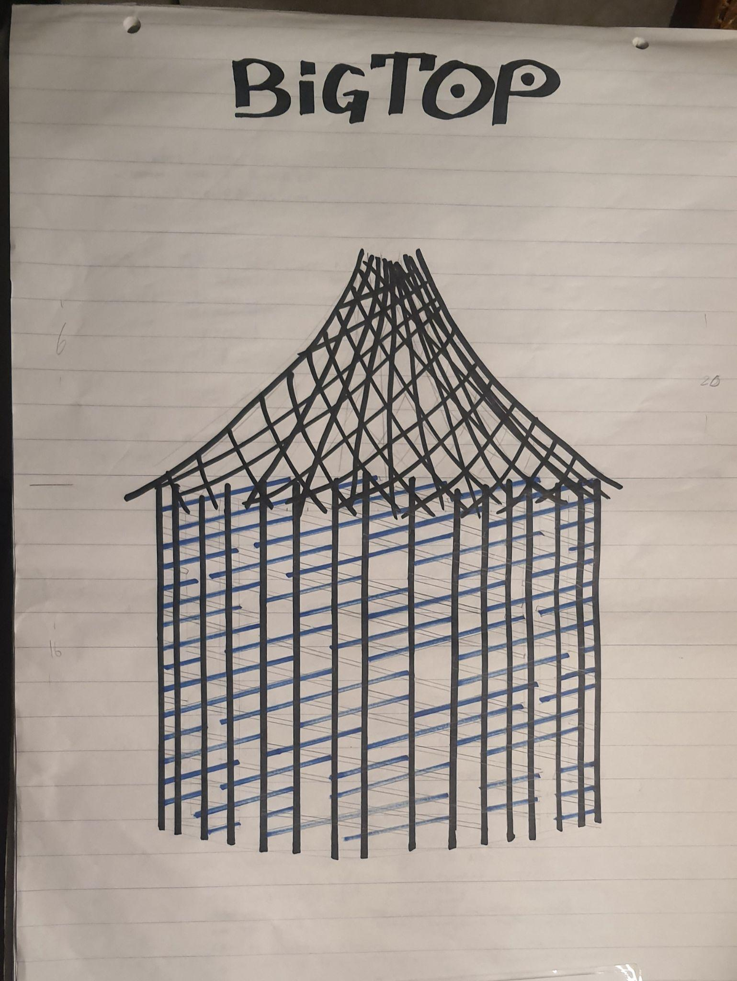
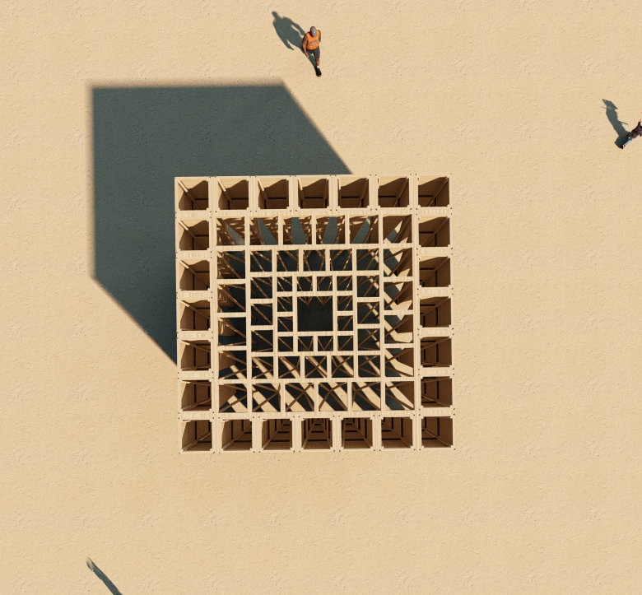
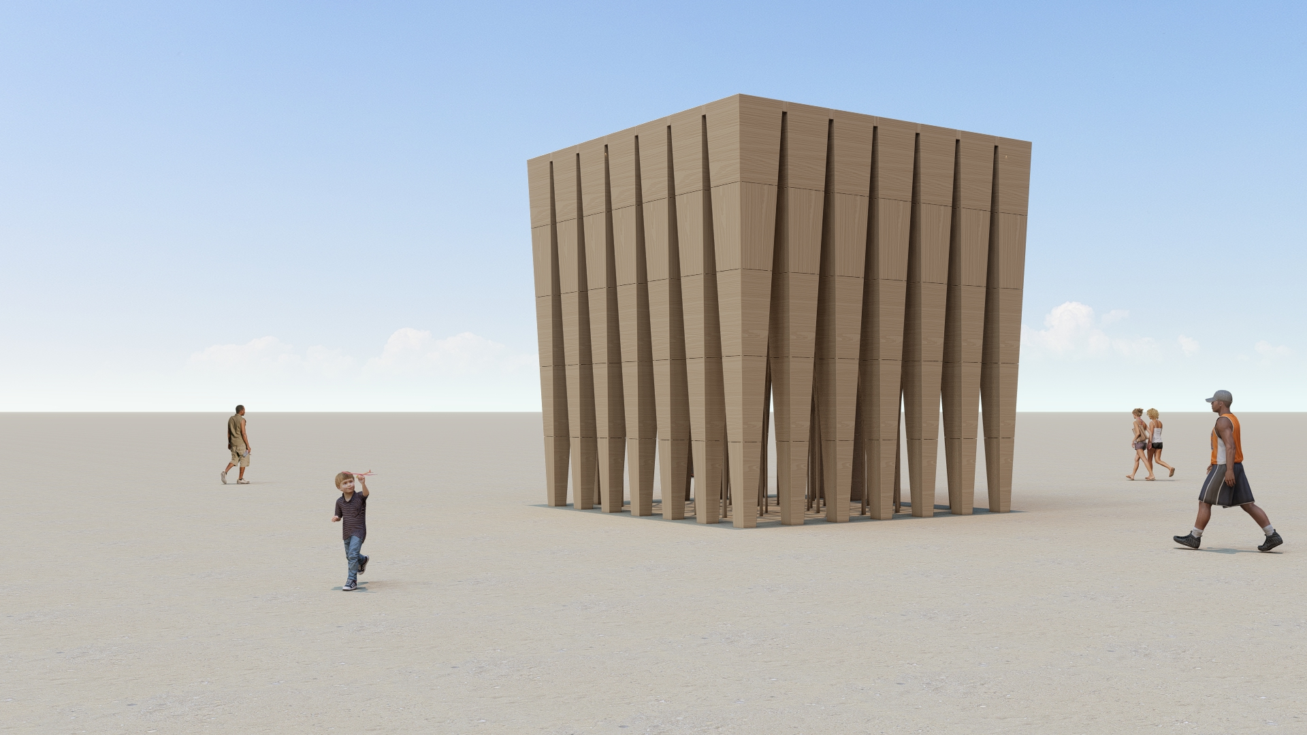
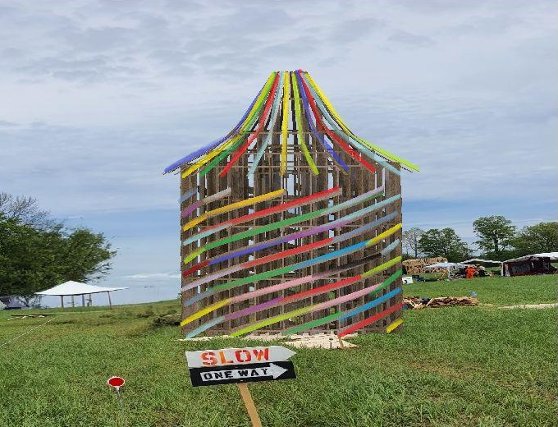
More sketch and rendering examples…
“Sacred Grove” 2025 Temple by Sky Ece Ulusoy
“BigTop” 2025 Effigy by Royal Molly Collective

Slide 14
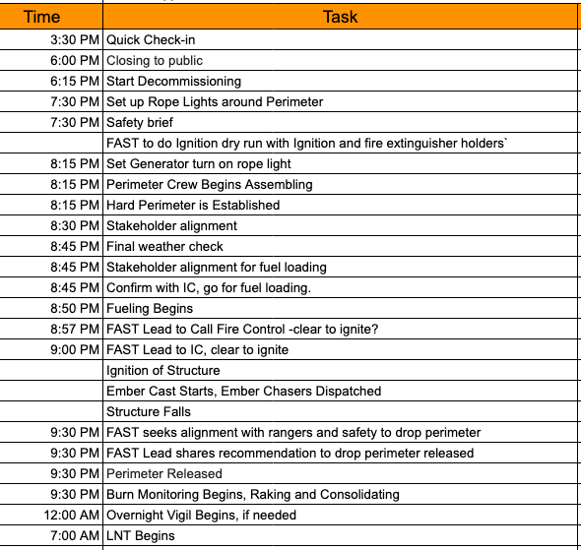
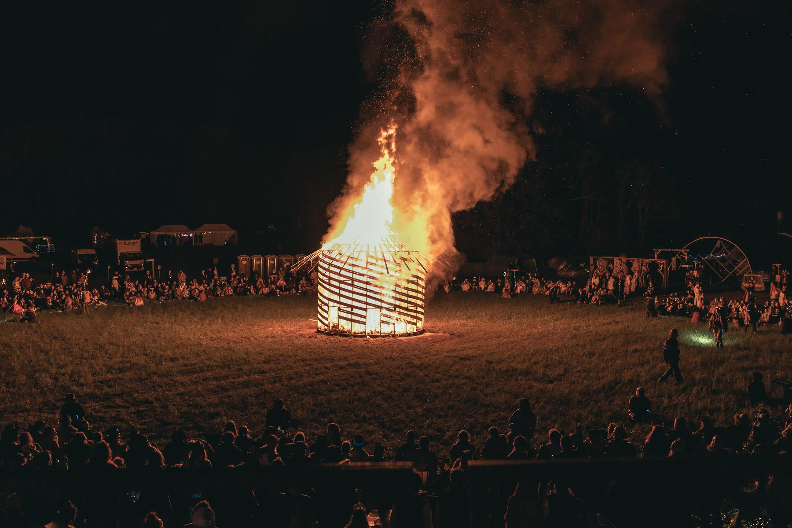
How does a typical “burn night” run?

Slide 15
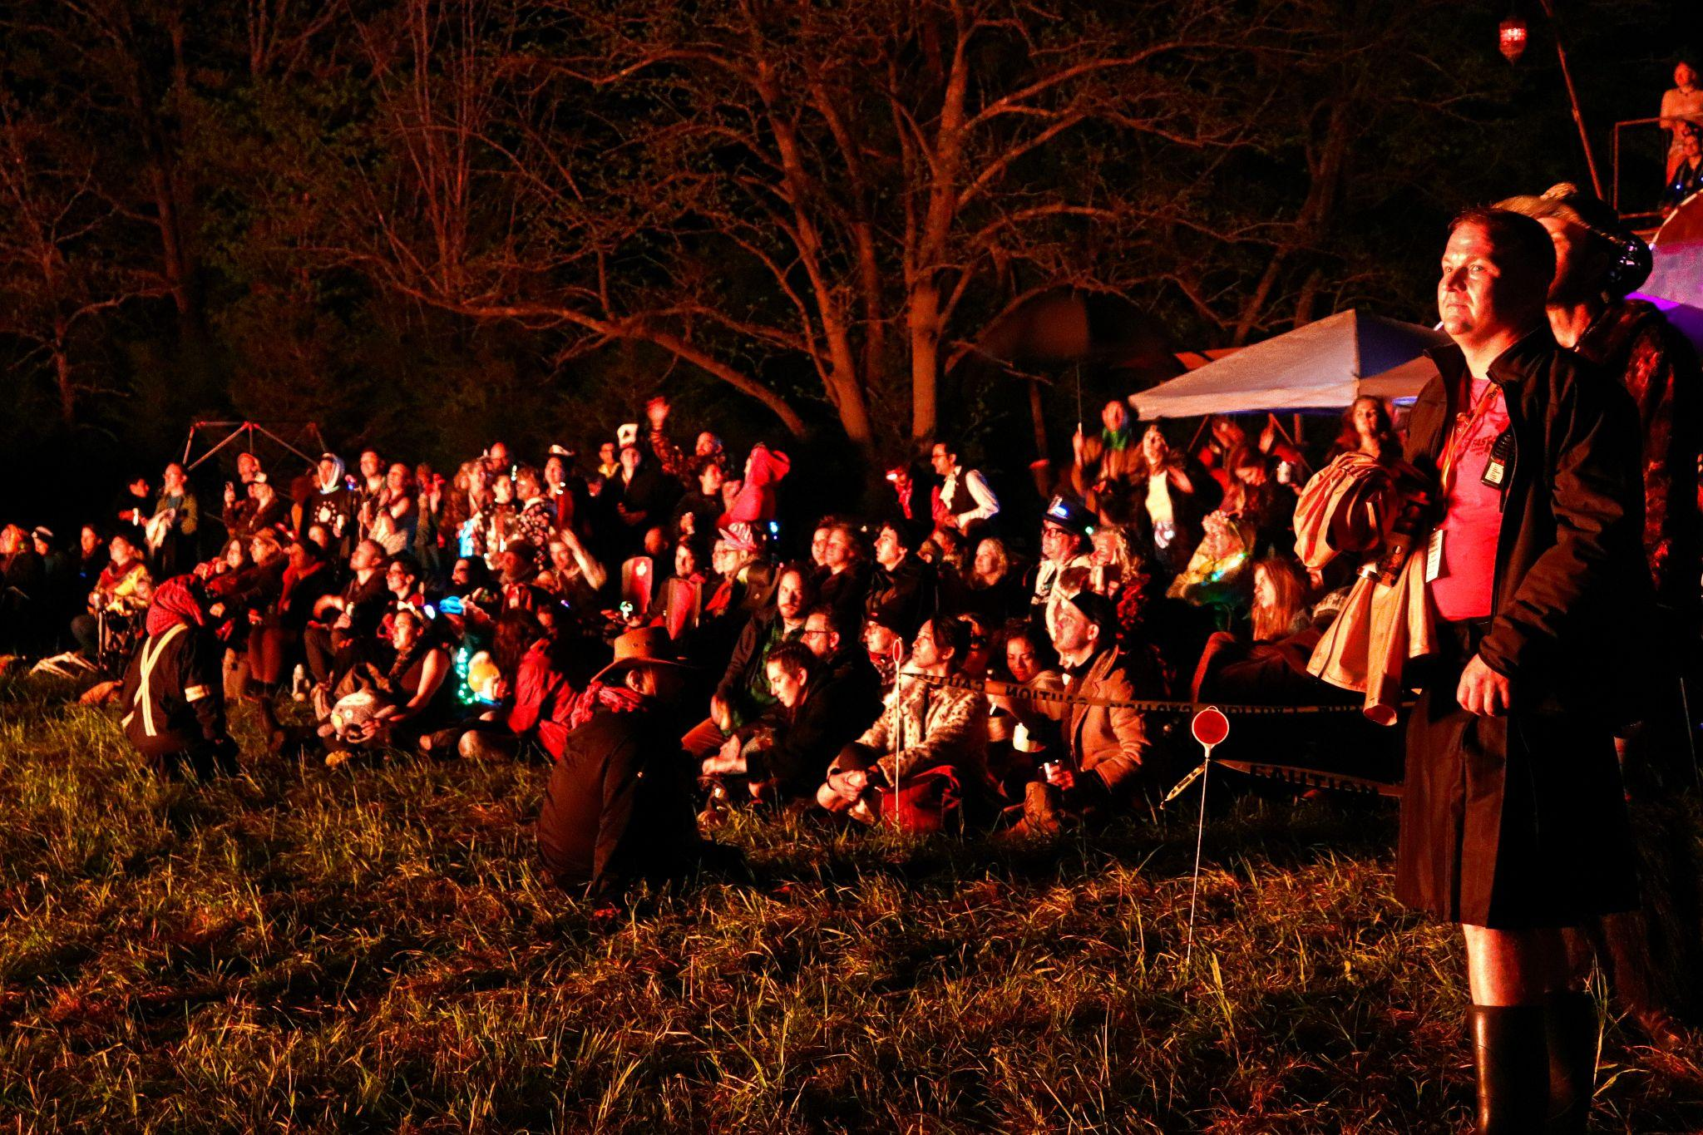
Fire Art Supporting
Documents:
Fueling & Burn Plan
The burn plan will be assessed by our FAST team, who will look at many things including:
  materials included,
  how the project will be fueled
  Any performance elements
  How it will be ignited
  Fuel storage
  Safety monitoring during the project’s active times

Slide 16
Fire Art Supporting Documents:
Fueling & Burn Plan
Familiarize yourself with our flame effect guidelines on our website: https://sideburn.ca/the-event/policies/flame-effects-and-fire-art/
There is a linked document within the Grant Information page which links to FAST Required Documentation for Planned Art Burns for more information
© captured by CARO

Slide 17
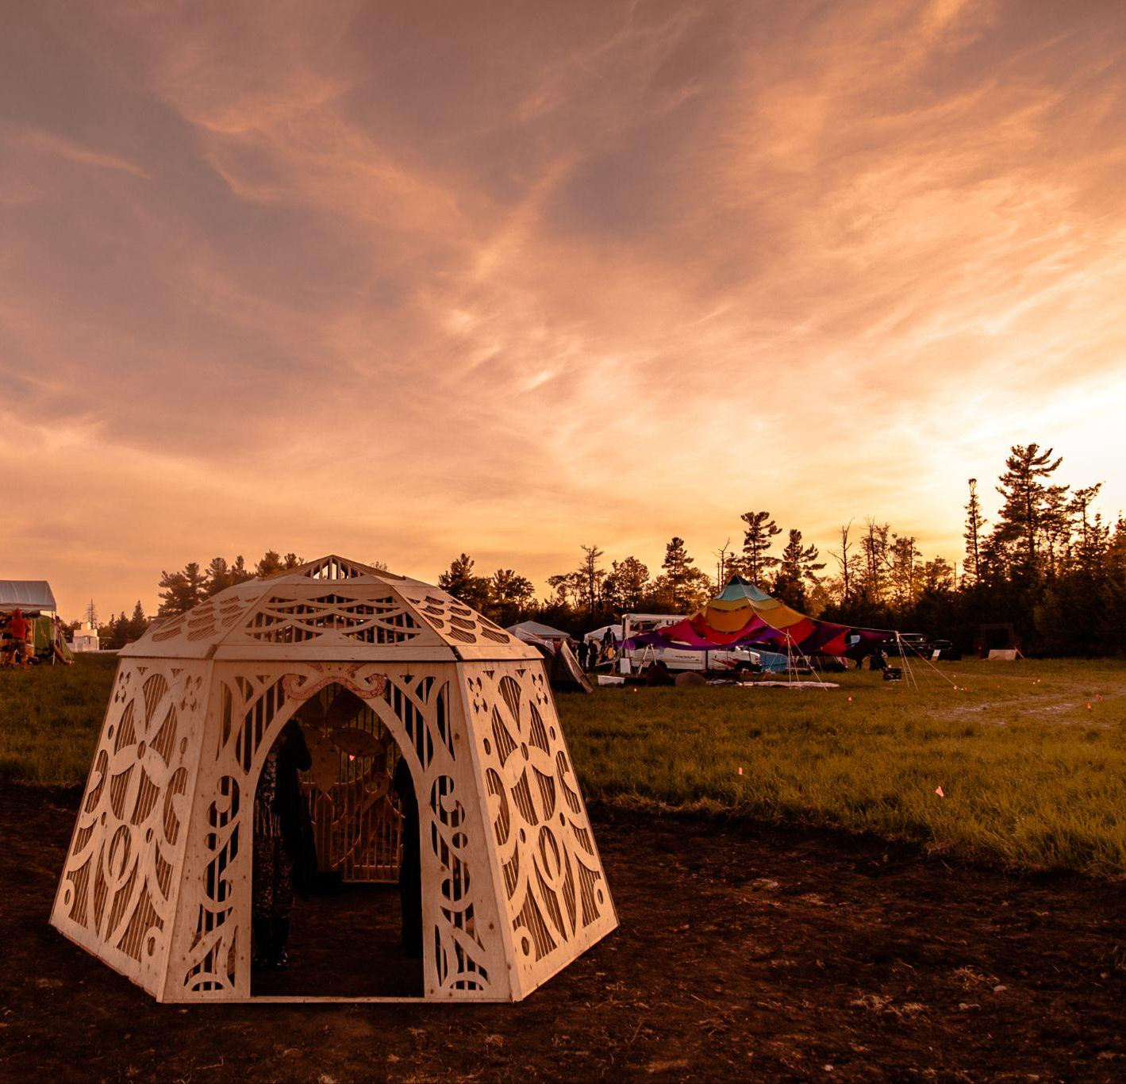
Build Materials - Fire Art
The material usage is of concern to us for several reasons including fumes, and particularly ember cast as the structure burns.
Prohibited Materials for burns:
  Paper, Cardboard, Paper Mache
  ⅛” or ¼”plywood
  Plywood with veneer layer
  OSB
  MDF
  Shims
  Plastic
  Wool & Leather
  Natural or synthetic fabric
  Anything likely to create large flying embers

Slide 18
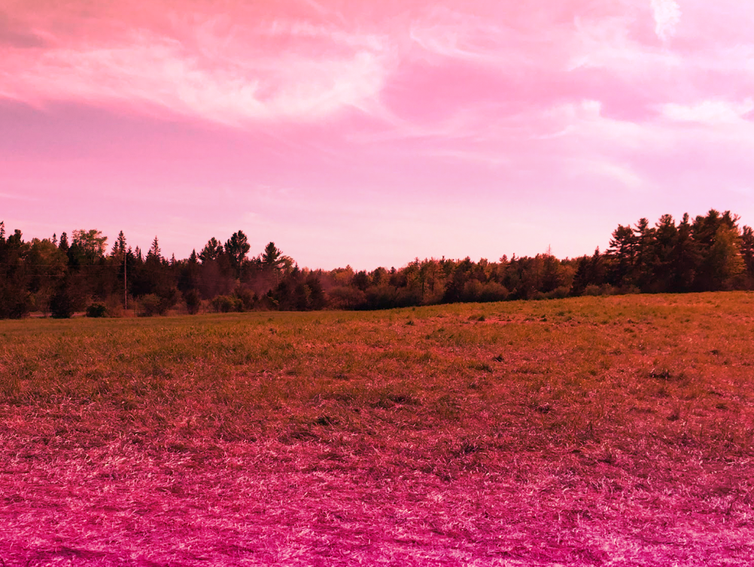
What we leave behind
We are a Leave No Trace (LNT) event. For Effigy and Temple teams, this means that:
Any metal hardware (nails, screw, brackets, etc.) need to be removed from the ash with a metal rake (provided by SideBurn)
The ash needs to be removed from the burn site - include a plan in your final application!
We make sure there is no lasting damage to the land.
Your “build team” should include people responsible for LNT after your project burns

Slide 19
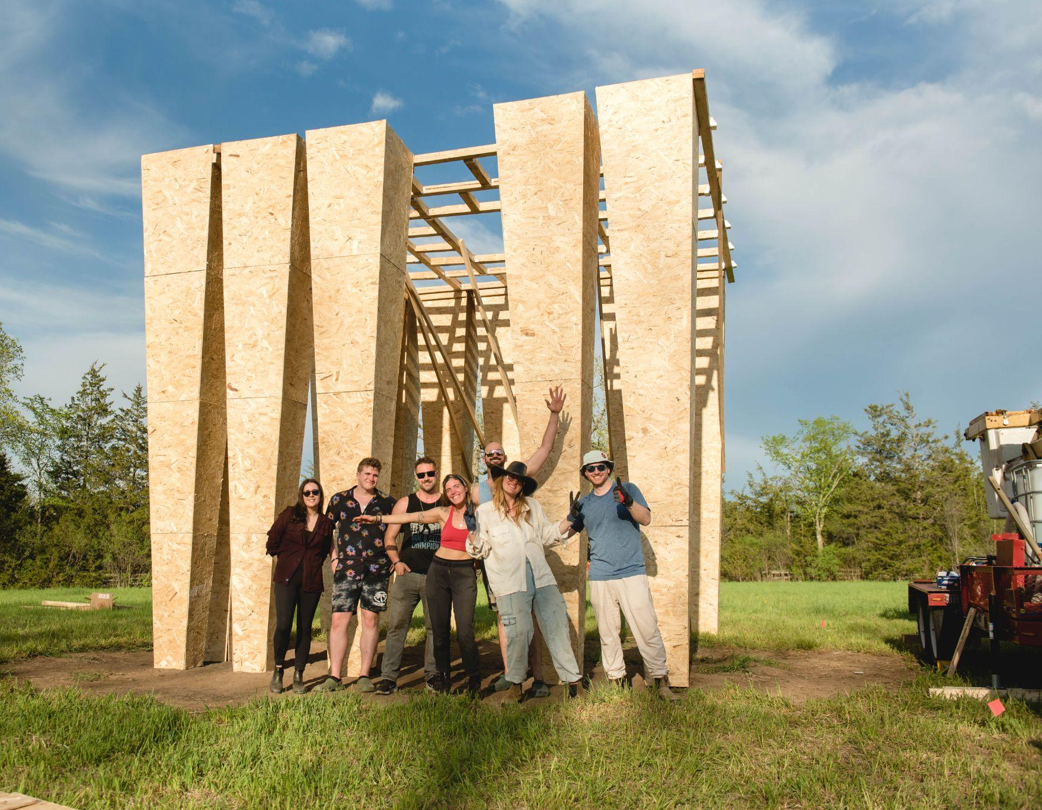
Build Team
You can get approval for build team members to arrive early
Ticket costs are NOT to be included in your budget
Artists/build team members may apply for ticket aid
Build teams may arrive as early as Monday, May 11 2026 to begin installing projects (possibility of advance approval to arrive earlier for complex projects)
SideBurn will allocate a dedicated area for your build team to camp, or team members can camp in open camping

Slide 20
Common Effigy and Temple Issues to Think About:
Pre-event: workshop space
Pre-event: transportation
Pre-event & on-site: volunteers and build teams
Process: design changes
On-site: managing your build team
On-site: materials shortage/calculation errors
On-site: weather events
Budget: consider fundraising! Build in a contingency amount.
Time: build in buffer time for bad weather, changing plans, and other delays

Slide 21
Resources
Art Grant Applications https://sideburn.ca/participate/art/
Budget Template - your budget does not need to be this complex, but it's a place to start
Burnable Art Guidelines: make sure to familiarize yourself with our policies
https://sideburn.ca/the-event/policies/flame-effects-and-fire-art/

Slide 22
Questions?
Contact info:
art@sideburn.ca
fast@sideburn.ca
THANK YOU to our 2025 Volunteer Photographers:
Charlie Lawton
Derek Sahama
Caroline Monte

