Slide 1
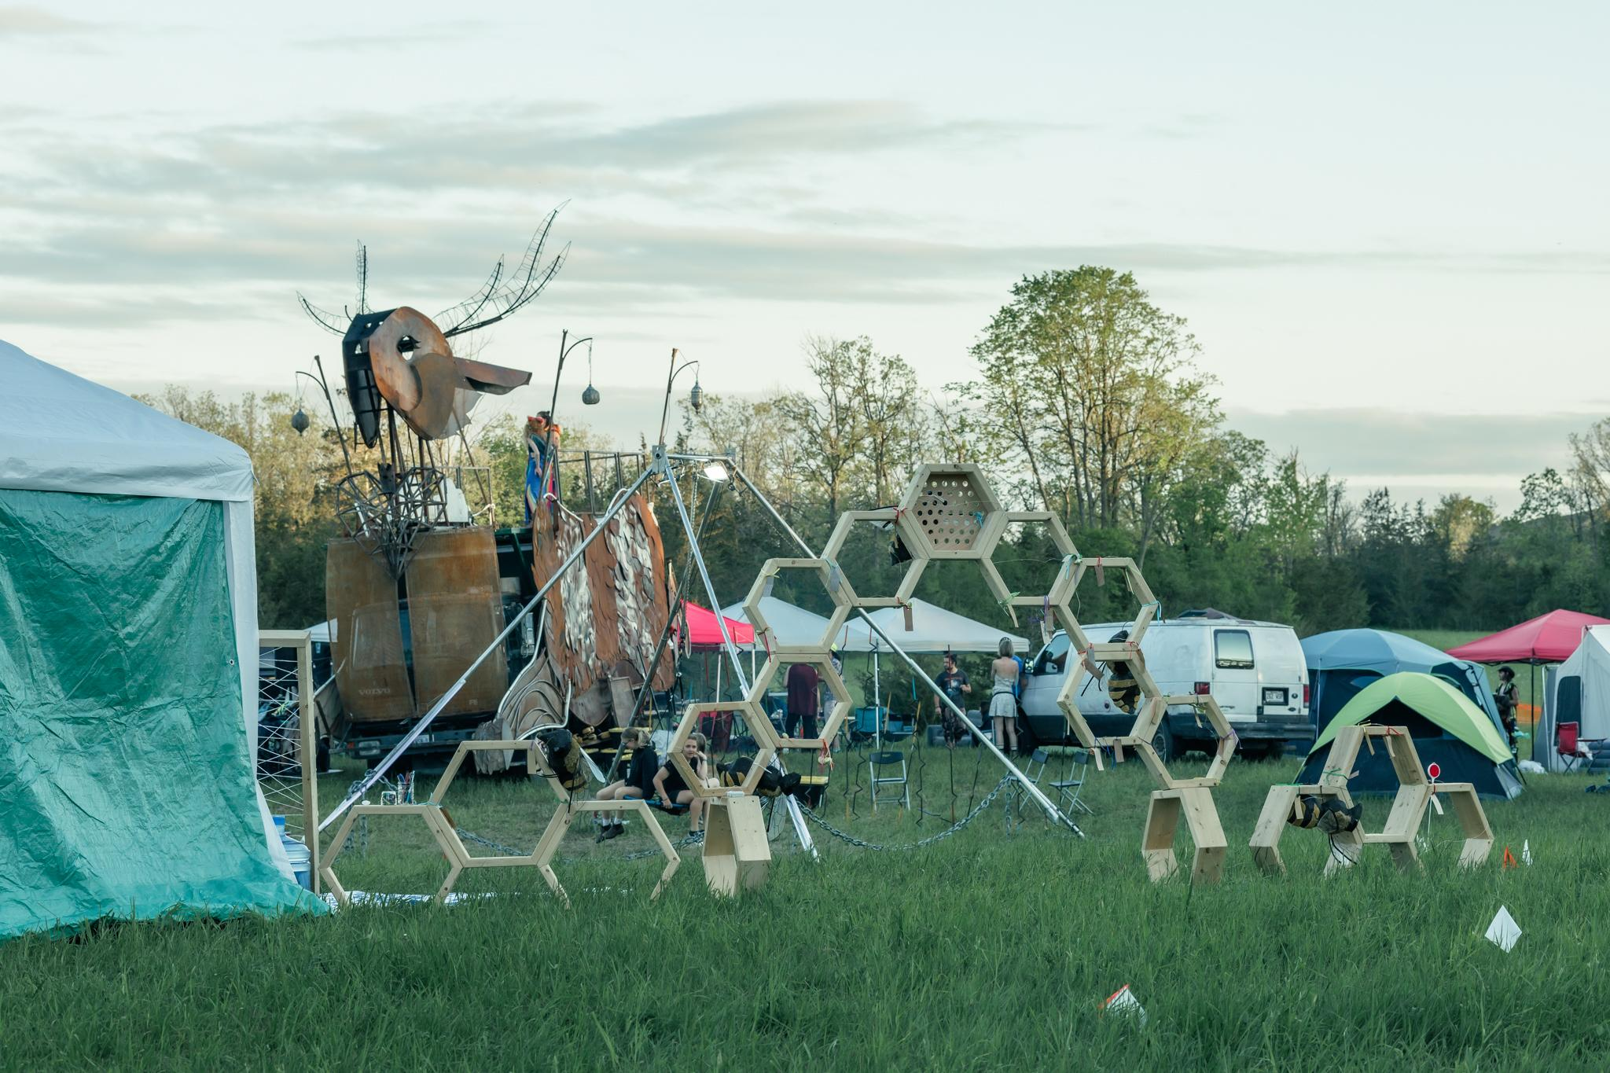

Art Grant Info Session
2026 Information Session

Slide 2
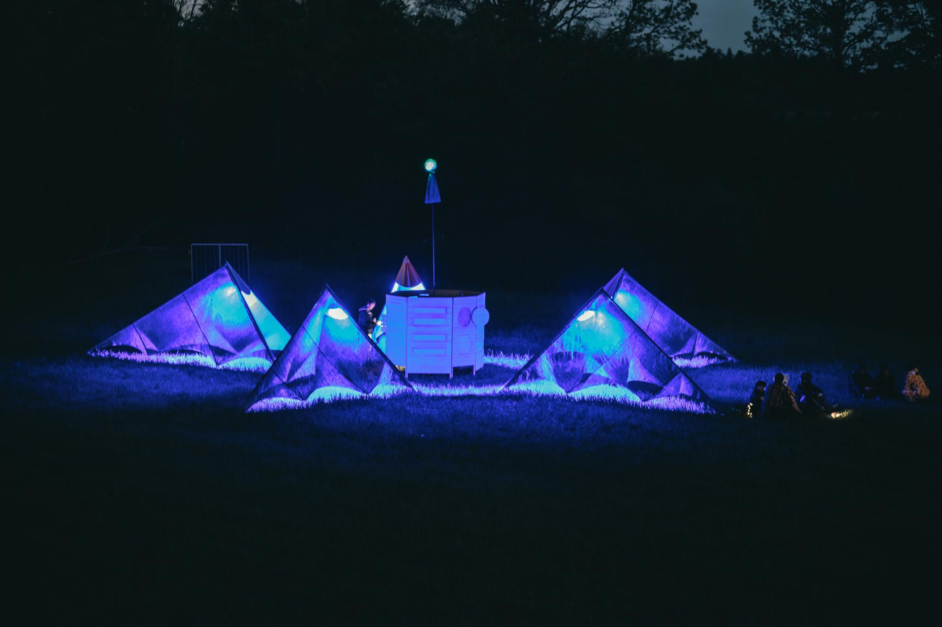

The Great Rewilding
14-18 May 2026

Slide 3
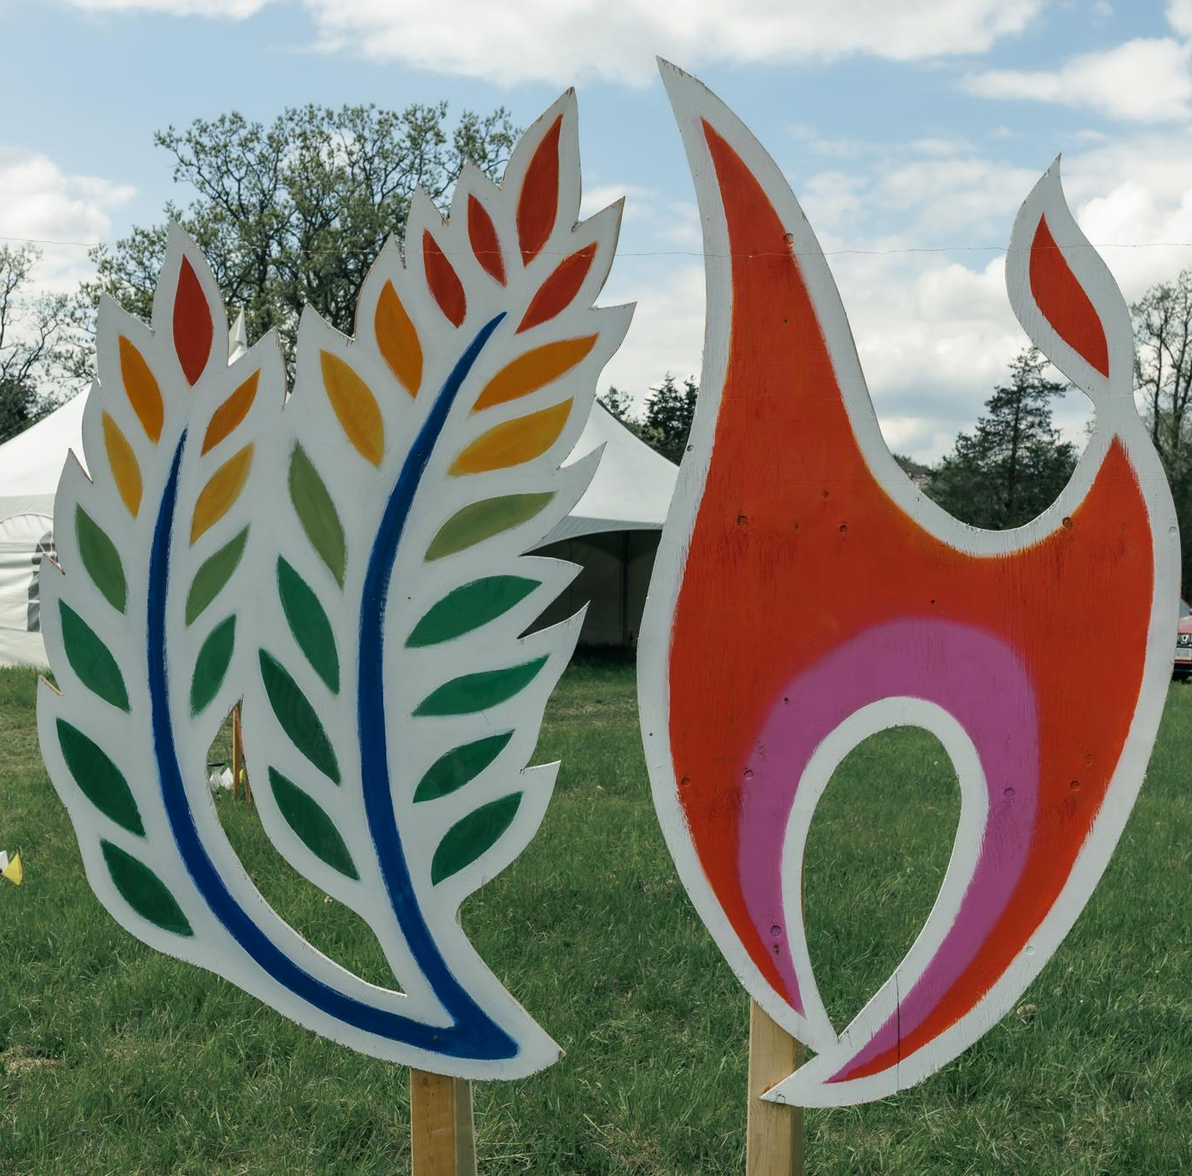
What is SideBurn?
A sanctioned Burning Man Regional Event.
We are guided by the 10 Principles of Burning Man.
It is run by a volunteer board of 12+ all year round. We have a healthy, long-standing, incorporated non-profit organisation behind the event.
The event has two ‘burn’ nights, Saturday and Sunday, where we burn two unique art pieces built out of wood.
We offer the opportunity for participants to come and unplug and camp for 4 days in Stone Mills.
We all bring the fun!
© captured by CARO

Slide 4
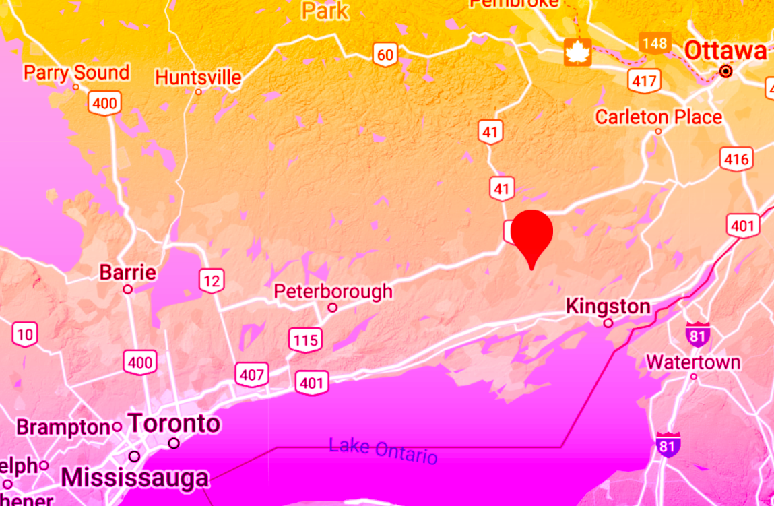
Where is SideBurn?
May 14-18 2026, Stone Mills, ON
2.5 hr drive from Toronto ………………………….
……………………………... 2 hr drive from Ottawa (north of Kingston)
Notes:
Same site as last year!

Slide 5
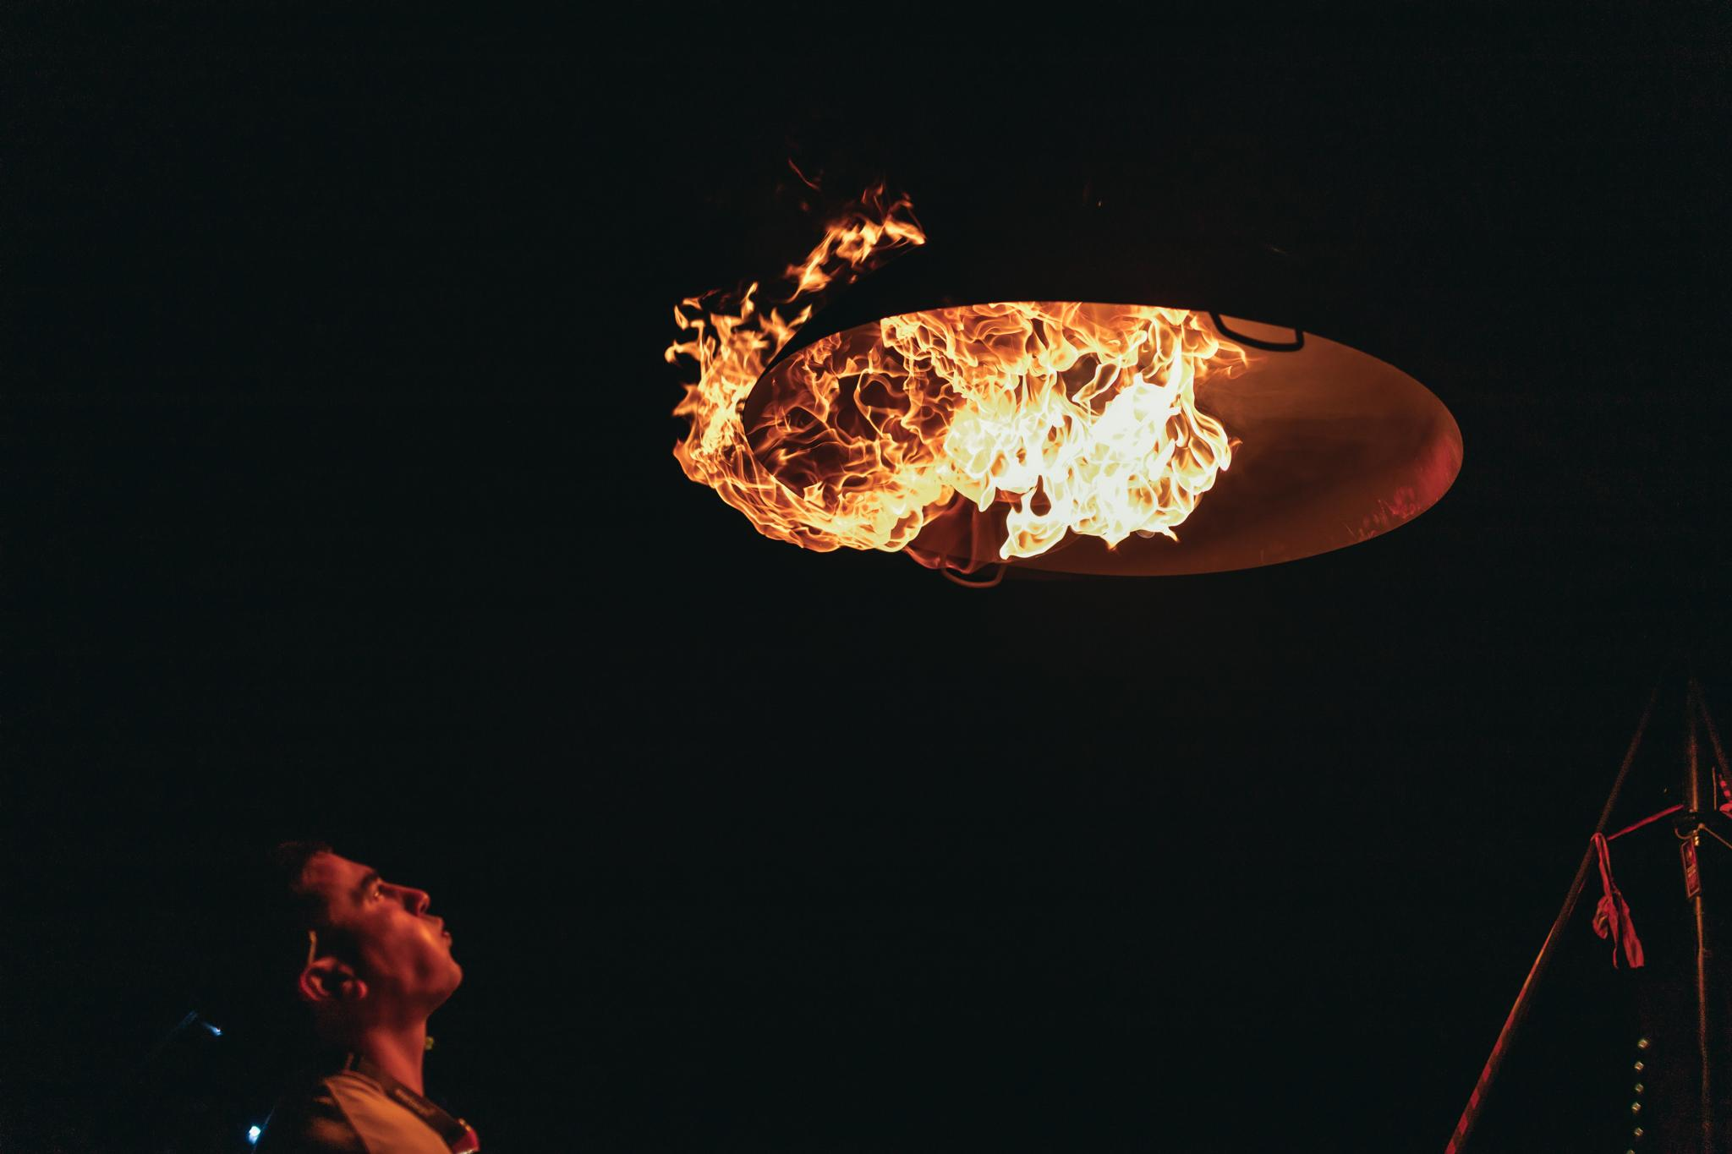
Grant Amounts
SideBurn offers:
Creators Grant - up to $1,200
Fire Art Creators Grant - up to $1,200
Legacy Grant - up to $700
Micro Grant - up to $150
75% of this amount is released right away when you accept the grant and sign the artist contract
The remaining 25% is released after the event
Notes:
The Art Grant Program is intended to support and promote projects that foster the participatory spirit at the core of the event. We provide funding for radically expressive, community-based, interactive, experimental, and cross-disciplinary projects that help define the creative atmosphere we strive to curate.

Slide 6
What did we fund in 2025?
44 art grants awarded - breakdown:
Creators Grant: 19
Micro Grant: 10
Legacy Grant: 11
Fire Arts Creators Grant: 4
$27,500 art grants funding, plus $5,500 each for Temple and Effigy = $38,500 in grant funds
7 grant projects had a fire art or flame effect component
5 additional “Independent Art” projects were submitted and received placement (self-funded, non-grant projects)
78 total applications received (not including effigy and temple). Breakdown of applications::
Creators Grant: 38
Micro Grant: 16
Legacy Grant: 17
Fire Arts Creators Grant: 7

Slide 7
Timeline & Deadlines
December 13, 2025: Virtual info session and Q&A
January 24, 2025: All art grant applications due by 11:59pm EST
January - February 2026: Art Grant Committee reviews art grants
ART GRANTS AWARD DATE: February 14, 2026
Late February 2026 directed ticket purchases open for artists
ON-SITE EARLY ARRIVAL May 13-14, 2026 (gates open to the public May 14 at noon)

Slide 8
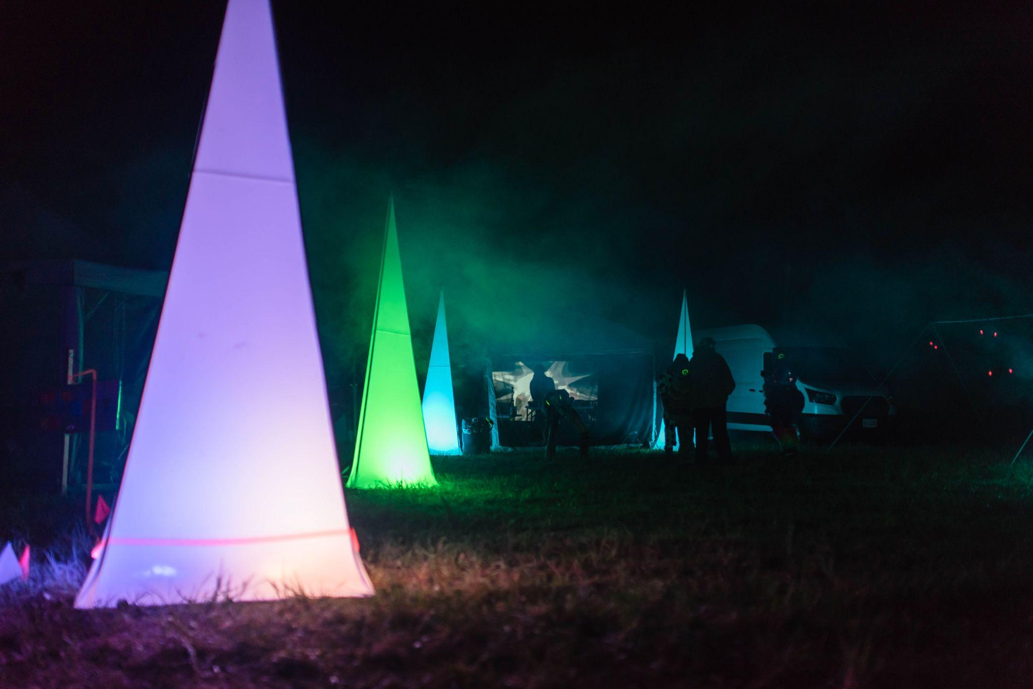
HOW IT WORKS: CRITERIA & REVIEW
Creativity: How original, interesting, relevant, daring, magical, and thought provoking is your idea?
Construction: Is your project feasible? Will you be able to build it within your proposed timeline and budget? Are you accountable for fire art restrictions and other safety considerations (ex. anchoring)?
Completeness: How well-thought-out is your project? How complete are your materials list, safety plan, and Leave No Trace plan? Did you submit a budget?
Interactivity: Does your project engage the senses? We prioritize projects that have the ability to engage two or more senses at a time!
© captured by CARO
Notes:
1. Artistic Excellence (Design & Philosophy)
How original, interesting, relevant, daring, magical, thought-provoking is your idea?
2. Completeness of Design
How well-thought-out is your project? You should provide enough information for us to imagine your creation and how it comes together.
3. Feasibility & Constructability
How feasible is your idea? Will it stay together? You should have a detailed plan for both the technical construction of your project as well as a schedule to ensure it happens on time, with buffers for potential setbacks.
4. Appropriateness of Budget
Your budget should have reasonable costs that match the value of your materials.
5. MOOP/LNT Plan
Your project should have minimal waste production, and a plan for cleaning any possible Matter Out Of Place (MOOP) that could be produced during the installation or strike of your project. This includes a plan for Leave No Trace (LNT) cleanup of ashes and refuse produced during the burn.
6. Safety and Risk Mitigation Plan
Yeah, we get it. Art is dangerous sometimes. But make sure you have a plan to minimize the amount of harm that can come to people interacting with your project.
7. Burn Plan and Ignition Plan
If your art project includes fire you must submit a burn plan with your application. This plan will be reviewed by our F.A.S.T team and grants will only be awarded to projects that have been approved. See here for a guide to creating a Burn Plan

Slide 9
HOW IT WORKS: CRITERIA & REVIEW
The Art Leads will anonymize all applications.
With members of the art grant committee, art leads will evaluate the grant submissions based on the criteria.
Through discussion-based consensus, the art grant committee will determine grant awards.
All recipients will receive an email indicating whether their art grant is awarded funding.
© captured by CARO
Notes:
1. Artistic Excellence (Design & Philosophy)
How original, interesting, relevant, daring, magical, thought-provoking is your idea?
2. Completeness of Design
How well-thought-out is your project? You should provide enough information for us to imagine your creation and how it comes together.
3. Feasibility & Constructability
How feasible is your idea? Will it stay together? You should have a detailed plan for both the technical construction of your project as well as a schedule to ensure it happens on time, with buffers for potential setbacks.
4. Appropriateness of Budget
Your budget should have reasonable costs that match the value of your materials.
5. MOOP/LNT Plan
Your project should have minimal waste production, and a plan for cleaning any possible Matter Out Of Place (MOOP) that could be produced during the installation or strike of your project. This includes a plan for Leave No Trace (LNT) cleanup of ashes and refuse produced during the burn.
6. Safety and Risk Mitigation Plan
Yeah, we get it. Art is dangerous sometimes. But make sure you have a plan to minimize the amount of harm that can come to people interacting with your project.
7. Burn Plan and Ignition Plan
If your art project includes fire you must submit a burn plan with your application. This plan will be reviewed by our F.A.S.T team and grants will only be awarded to projects that have been approved. See here for a guide to creating a Burn Plan

Slide 10
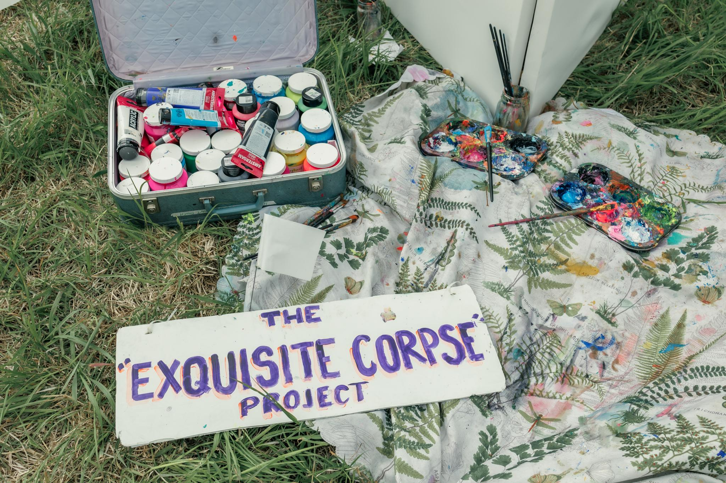
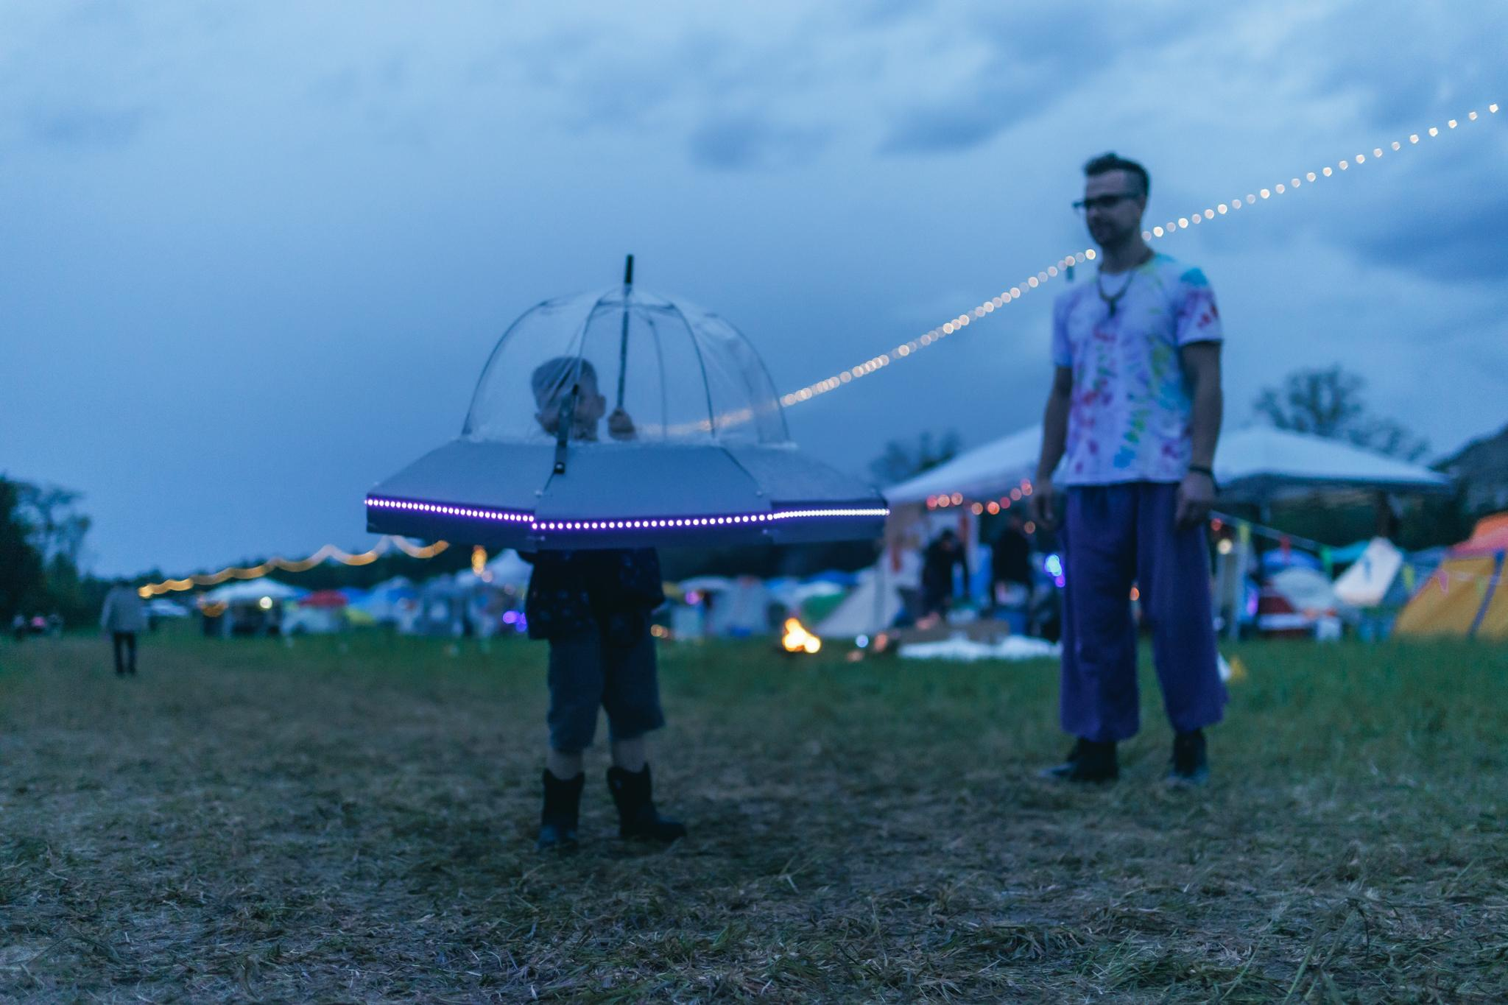
Creators Grant & Fire Art Creators Grant
Intended to help you make something new!
Apply for up to $1,200
Since 2025 we have a specific Fire Art Creators category
Submissions to this category will have the opportunity to talk with our FAST team after their application, if needed
If your project will cost more than $1,200, you should include a plan for funding the budgetary shortfall
© captured by CARO

Slide 11
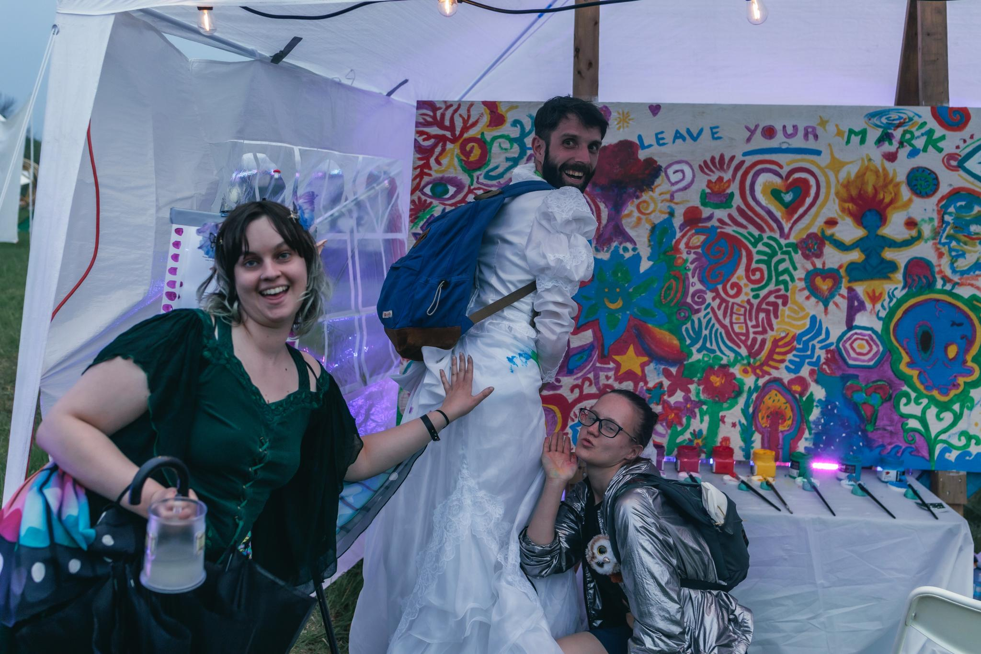
Micro Grants
-up to $150
-intended to fund inexpensive things that add, whimsy, magic, fun, and curiosity
-great for: workshop supplies, small installations, kids projects
-need a location for a workshop? Consider Centre Camp , or teaming up with a theme camp to host your workshop

Slide 12
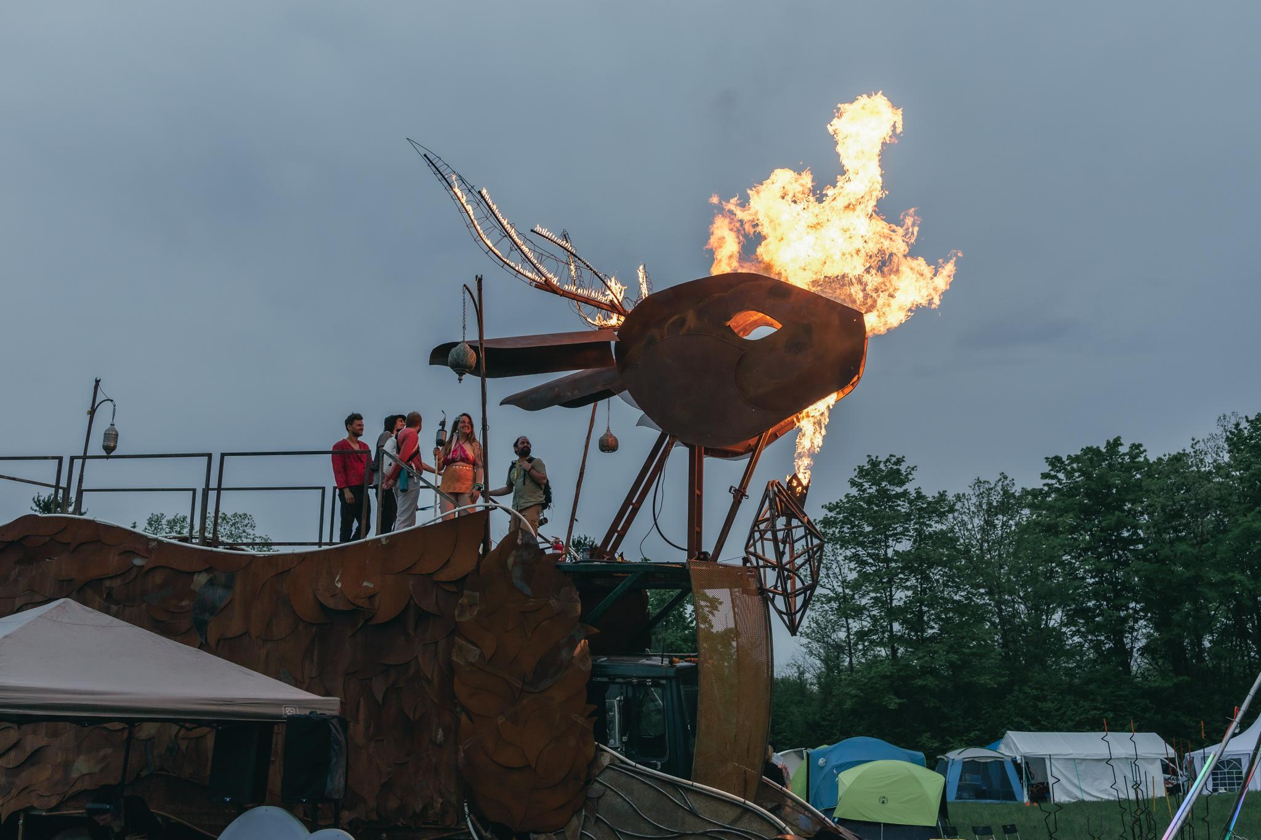
Legacy Grants
Intended to help fund the repair, refurbishment, improvement and/or expansion of existing art projects
Apply for up to $700
Show us in your budget/project description how you’ll make up for any expenses not covered by the grant (ex. By fundraising, other grants, theme camp dues, personal investment…)

Slide 13
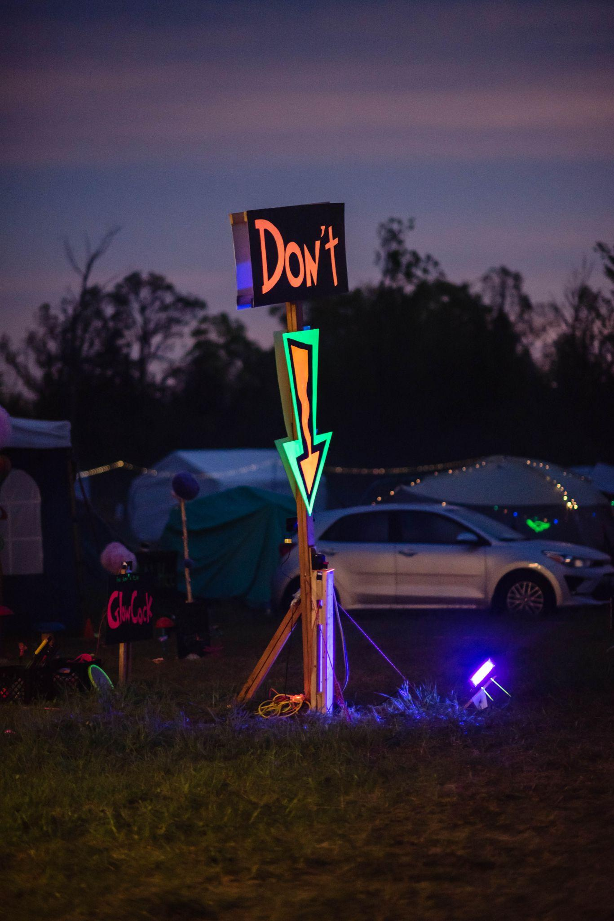
What we do & don’t fund
What can an Art Grant pay for?
An Art Grant is primarily intended to subsidize fabrication costs for your project to appear at SideBurn. You can pay for construction materials like wood, hardware, paint and metal. You can also pay for electronic components like LED strips, transistors, control boards and Arduinos. Fuel for generators or fire arts can also be paid for with your grant.
Keep your receipts!
What we DON’T fund:
Firewood
New supplies for performers (ex. Fire fans, DJ equipment)
Your ticket; your personal transportation costs

Slide 14
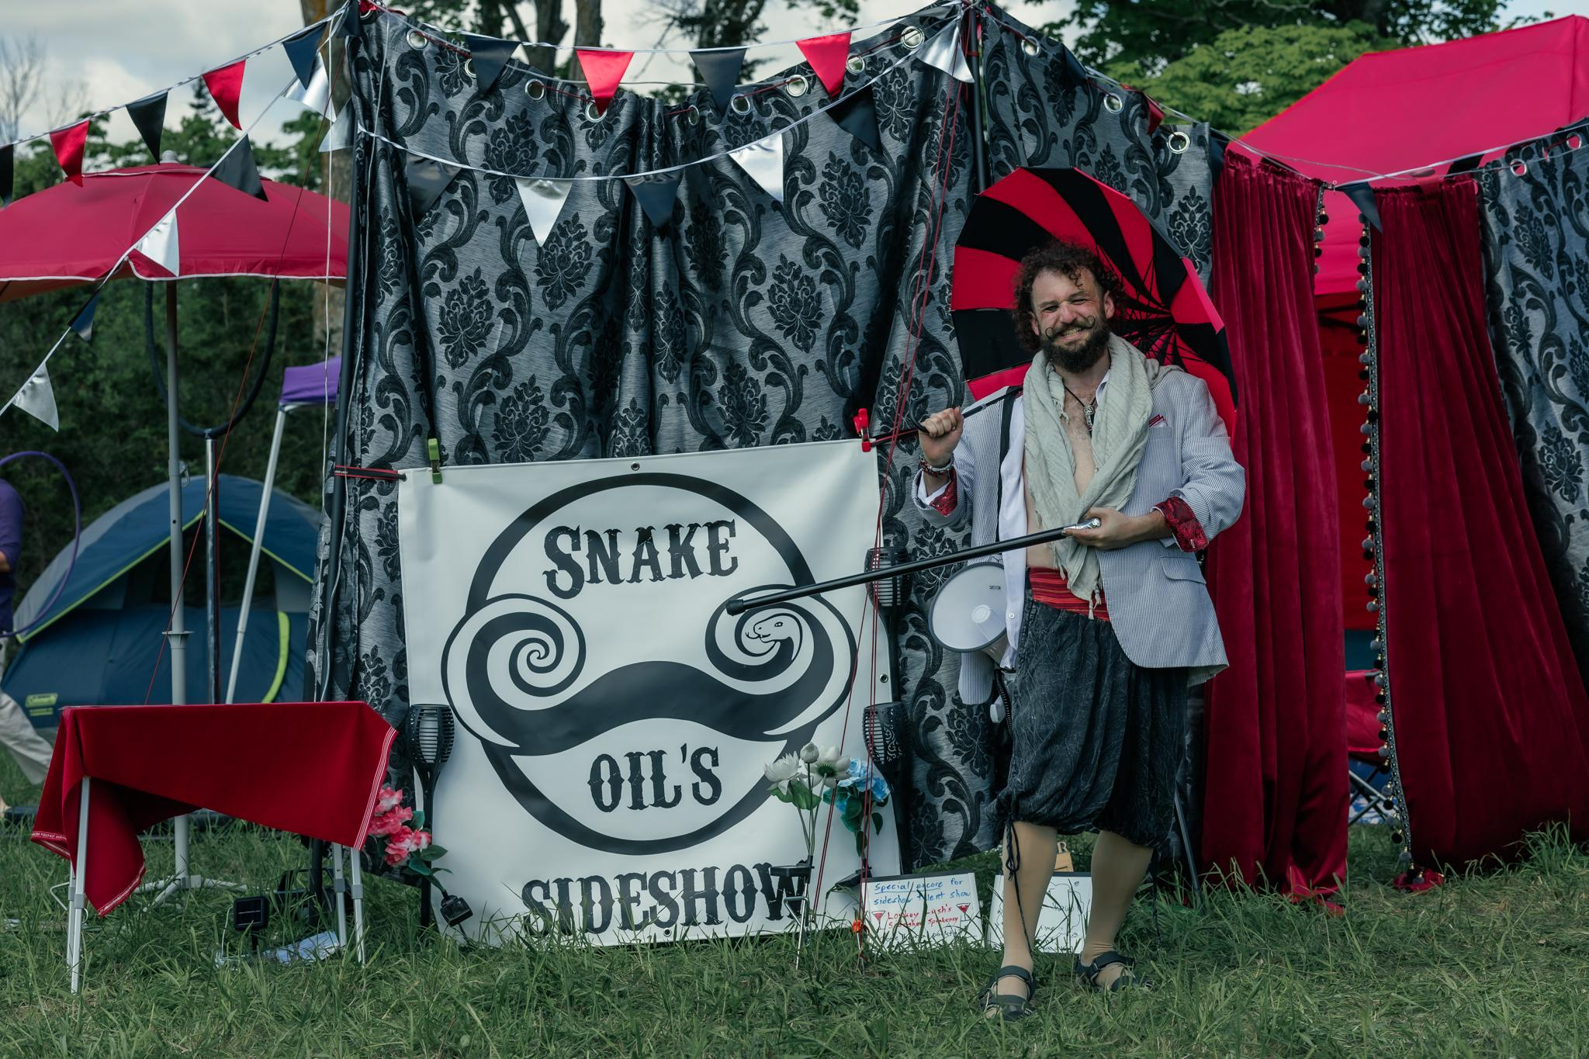
Theme Camp vs Art Grants
What should be a theme camp grant rather than an art grant?

Slide 15
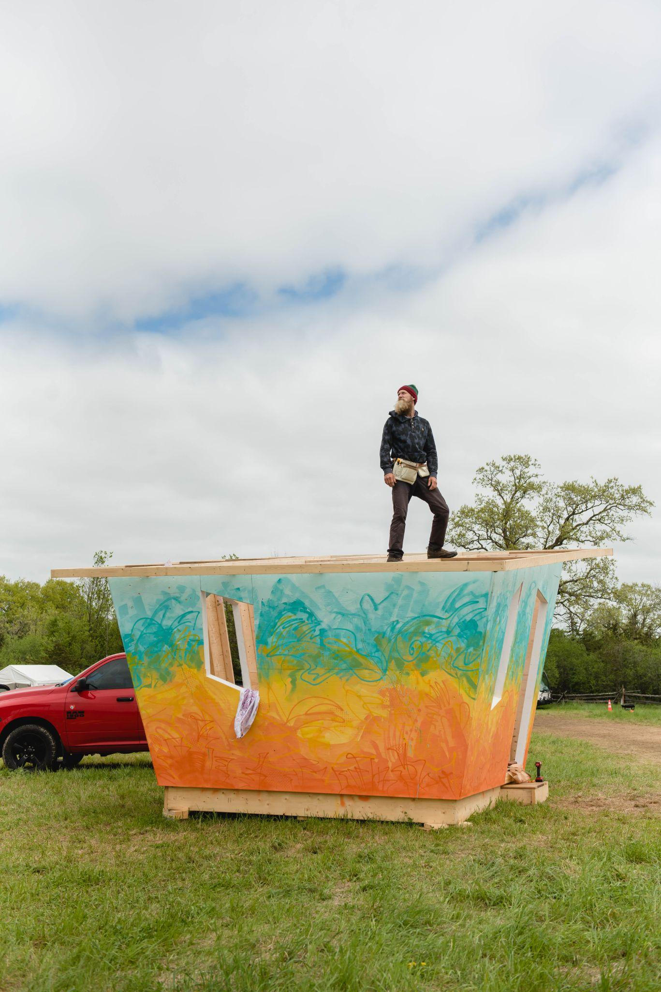
Supporting Documents: Budget, Renderings/Diagrams
All grant applications should include at least one image: a sketch, hand drawn rendering, or computer generated renderings are all acceptable
All projects should include a budget - a list of materials and anticipated costs, transportation expenses, and any equipment rental or workshop expenses
Submissions involving FIRE should include a fuel storage plan, and operational safety plan
Notes:
Upload your supporting documents directly on our website!

Slide 16
Artist Expectations
The artist shall be responsible for:
Stage 1: Contract
Acceptance of grant by signing and returning the Art Grant Contract
Stage 2: Planning & Preparation
Submission of any additional safety documentation (if required)
Updating the Art department on the progress of the project, including any major changes or modifications to the project
Stage 3: Execution - projects should be done setup by Friday at noon
Delivery of the project as described (or having notified the Art department of any major changes to the proposed project):
Build/set up of the project at SideBurn according to the timelines in the Art Grant Contract
Check in for placement upon arrival, and report completion of setup
Ongoing maintenance of the project during the event: checking the artwork daily for safety and security (ex. guy wires); supervision during operation hours if required (ex. if the project includes flame effects); regular leave-no-trace sweeps of the project area during the event.
Stage 4: Completion
De-installation of the project on the date agreed upon in the Art Grant Contract
Successful leave-no-trace inspection of the project area
Submission of project receipts to art@sideburn.ca

Slide 17
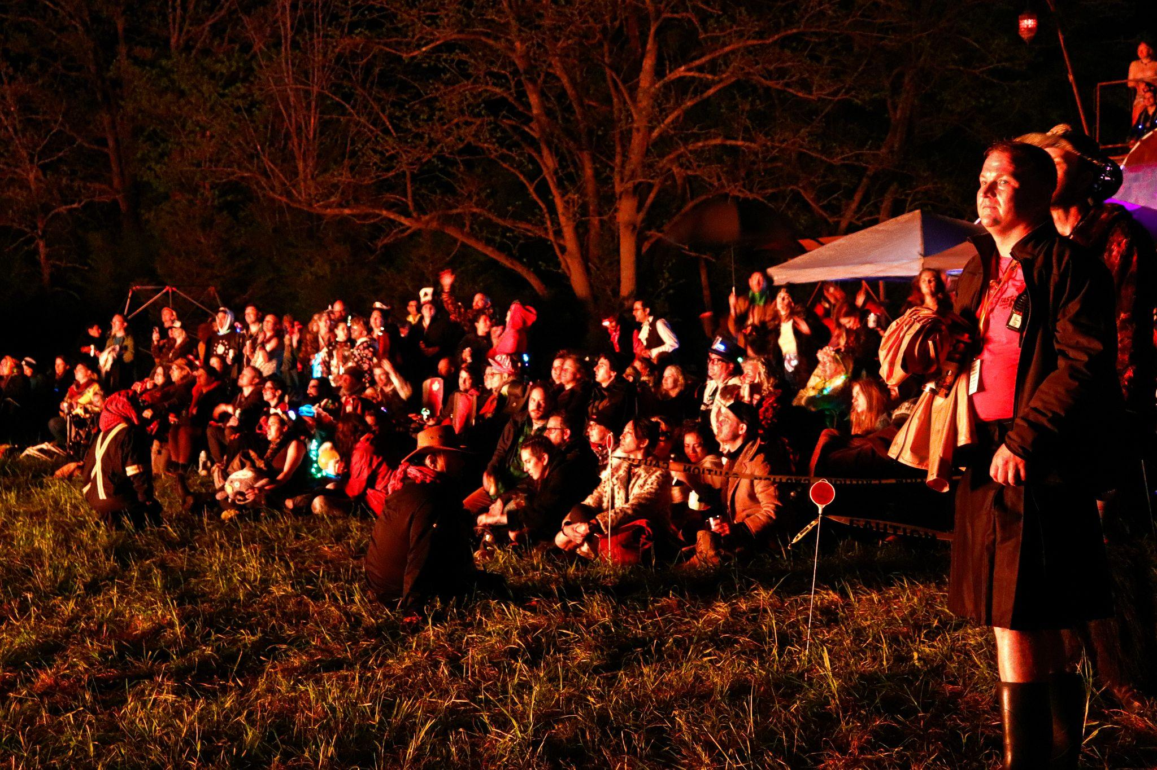
Fire Art Supporting
Documents:
Fueling & Burn Plan
The burn plan will be assessed by our FAST team, who will look at many things including:
materials included,
how the project will be fueled
Any performance elements
How it will be ignited
Fuel storage
Safety monitoring during the project’s active times

Slide 18
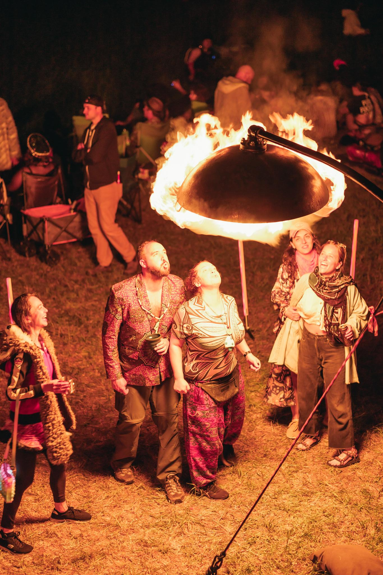
Fire Art Supporting Documents:
Fueling & Burn Plan
Familiarize yourself with our flame effect guidelines on our website: https://sideburn.ca/the-event/policies/flame-effects-and-fire-art/
There is a linked document within the Grant Information page which links to FAST Required Documentation for Planned Art Burns for more information
© captured by CARO

Slide 19
Build Materials - Fire Art
The material usage is of concern to us for several reasons including fumes, and particularly ember cast as the structure burns.
Prohibited Materials for burns:
Paper, Cardboard, Paper Mache
⅛” or ¼”plywood
Plywood with veneer layer
OSB
MDF
Shims
Plastic
Wool & Leather
Natural or synthetic fabric
Anything likely to create large flying embers

Slide 20
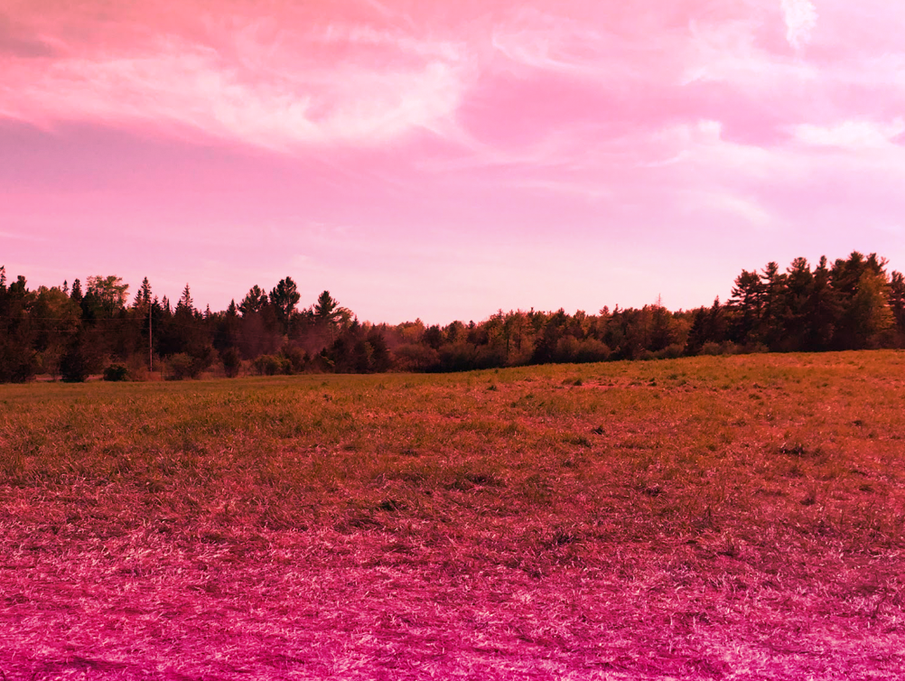
What we leave behind
We are a Leave No Trace (LNT) event. For Effigy and Temple teams, this means that:
Any metal hardware (nails, screw, brackets, etc.) need to be removed from the ground
Any holes or trenches from cables should be filled in
We make sure there is no lasting damage to the land.

Slide 21
Common Art Challenges to Think About:
Pre-event: transportation
Process: design changes
On-site: will you come for early arrival?
On-site: materials shortage/calculation errors
On-site: weather events
Budget: consider fundraising! Build in a contingency amount.
Time: build in buffer time for bad weather, changing plans, and other delays

Slide 22
Resources
Art Grant Applications https://sideburn.ca/participate/art/
Budget Template - your budget does not need to be this complex, but it's a place to start
Burnable Art Guidelines: make sure to familiarize yourself with our policies
https://sideburn.ca/the-event/policies/flame-effects-and-fire-art/

Slide 23
Questions?
Contact info:
art@sideburn.ca
fast@sideburn.ca
THANK YOU to our 2025 Volunteer Photographers:
Charlie Lawton
Derek Sahama
Caroline Monte

